Slide 1
Bitcoin Price Predictor by – manoj rana

Slide 2
Model used
Linear Regression
Support Vector Regression (SVR)
Decision Tree

Slide 3

Linear regression is a type of supervised machine-learning algorithm that learns from the labelled datasets and maps the data points with most optimized linear functions which can be used for prediction on new datasets. It assumes that there is a linear relationship between the input and output, meaning the output changes at a constant rate as the input changes. This relationship is represented by a straight line.
Linear Regression

Slide 4

Support Vector Regression (SVR)
support vector regression (SVR) is a type of support vector machine (SVM) that is used for regression tasks. It tries to find a function that best predicts the continuous output value for a given input value.
SVR can use both linear and non-linear kernels. A linear kernel is a simple dot product between two input vectors, while a non-linear kernel is a more complex function that can capture more intricate patterns in the data. The choice of kernel depends on the data's characteristics and the task's complexity.

Slide 5
Decision Tree
Decision Tree helps us to make decisions by mapping out different choices and their possible outcomes. It’s used in machine learning for tasks like classification and prediction. In this article, we’ll see more about Decision Trees, their types and other core concepts.
A Decision Tree helps us make decisions by showing different options and how they are related. It has a tree-like structure that starts with one main question called the root node which represents the entire dataset. From there, the tree branches out into different possibilities based on features in the data.
Root Node: Starting point representing the whole dataset.
Branches: Lines connecting nodes showing the flow from one decision to another.
Internal Nodes: Points where decisions are made based on data features.
Leaf Nodes: End points of the tree where the final decision or prediction is made.

Slide 6
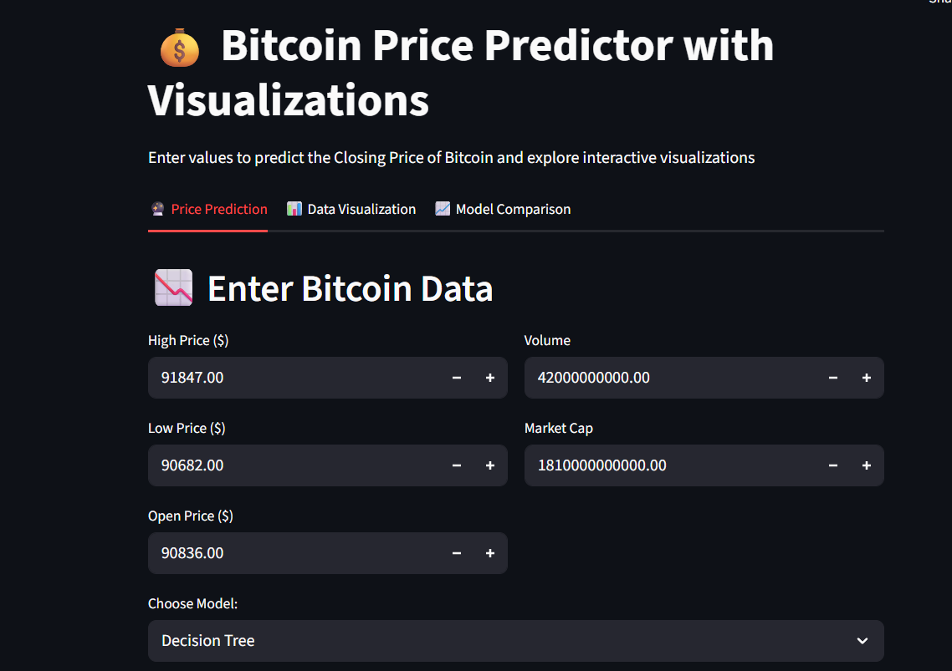
Price prediction

Slide 7
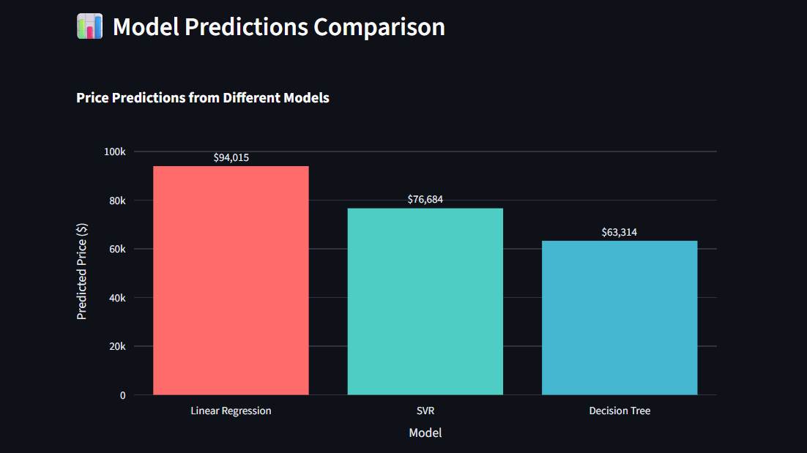
Model prediction comparison

Slide 8

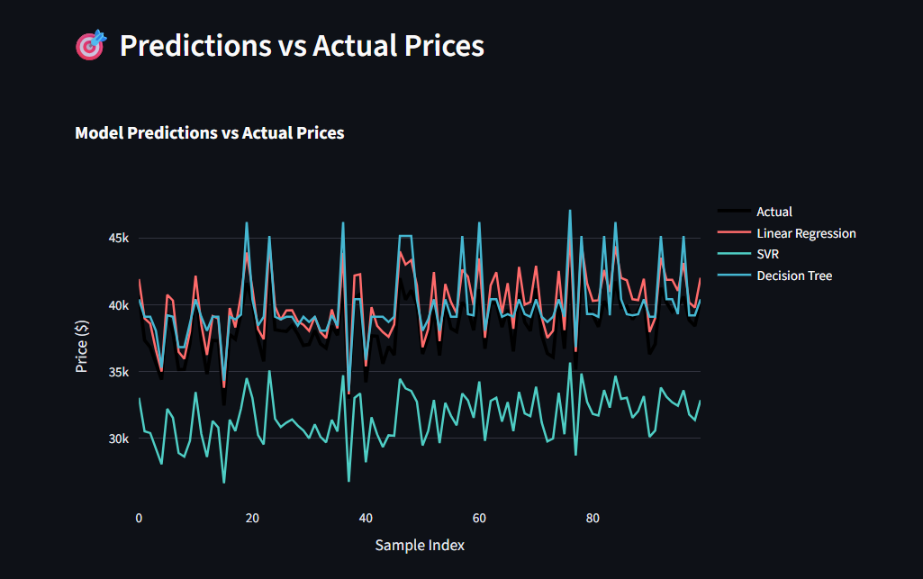
Prediction vs actual price

Slide 9

Thank you

